Slide 1
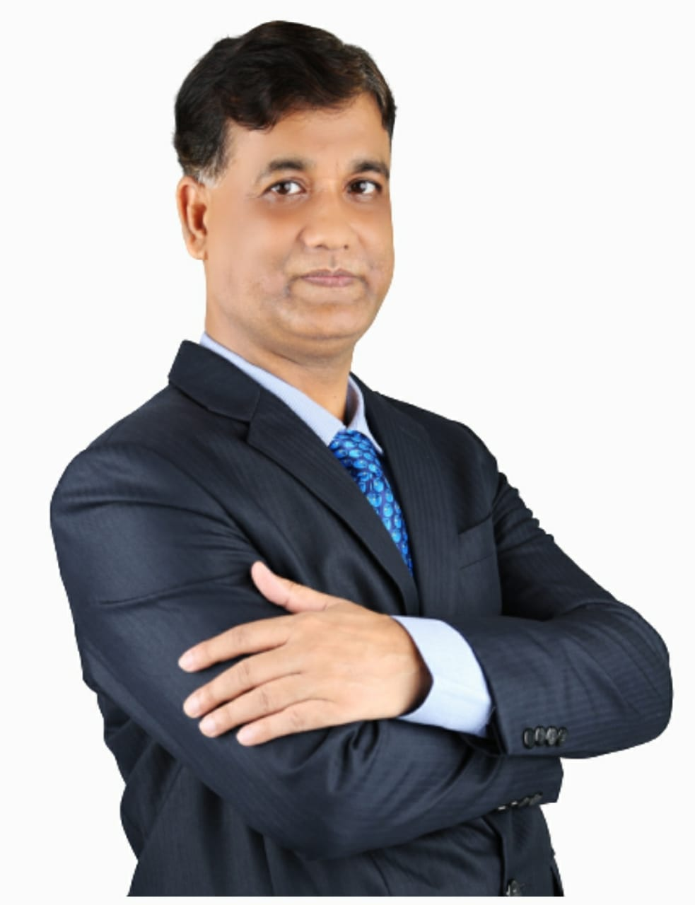
DEPARTMENT OF ISLAMIC STUDIES ISLAMIC UNIVERSITY OF SCIENCE AND TECHNOLOGY, AWANTIPORA, J&K, INDIA Monthly Online Lecture Series #L7 ISLAMIC ECONOMICS: CHALLENGES AND PROSPECTS (9 October 2022, Sunday, 05:15 PM IST/07:45 PM MYT)
PROFESSOR MD. AMINUL ISLAM
Faculty of Business and Communication,
Universiti Malaysia Perlis
(Invited Speaker)
DR. AFROZ AHMAD BISATI
Head, Department of Islamic Studies, IUST
(Organiser)
DR. ALI MUHAMMAD BHAT
Assistant Professor, Department of Islamic Studies, IUST
(Moderator)
LINK TO JOIN:
http://meet.google.com/tef-xitm-afh

