Slide 1
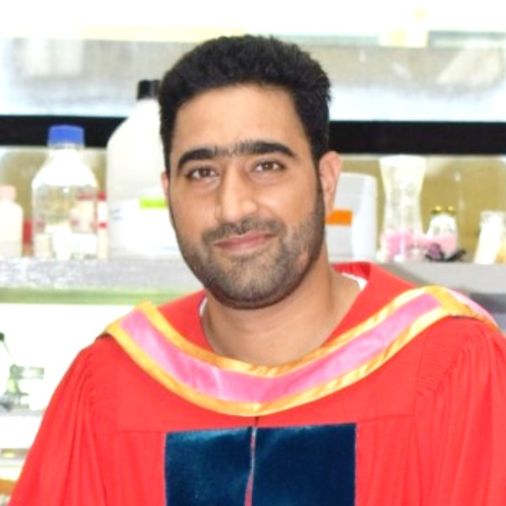
EXPERT SESSION
ON
CAREER OPPORTUNITIES AS A FOOD SCIENCE RESEARCHER
(Date: 07-05-2024)
Guest Speaker
Dr. Saqib Gulzar
Marie Skłodowska-Curie Actions Postdoctoral Fellow
University of Lleida, Lleida, Spain
Moderator
Dr. Nisar Ahmad Mir
(Assistant Professor, I/C: Alumni Coordinator)
Organized by
Department of Food Technology,
Islamic University of Science and Technology, Awantipora, UT of J & K.
In Collaboration with Alumni Connect

